Slide 1
Learn JavaScript with fun, build an UFO hunter game Object Prototypes

Slide 2
Prototype-based OOP in JavaScript
In JavaScript, almost everything is an object.
Value types in JavaScript are categorized into primitive values and objects. Apart from the primitives (e.g. numbers, strings, booleans, undefined, null), everything is an object. Objects include arrays, functions, dates, built-in objects, wrappers for primitives and user defined objects too.
Every JavaScript object has an internal "prototype" property, often called prototype, which points to the object from which it directly inherits.

Slide 3
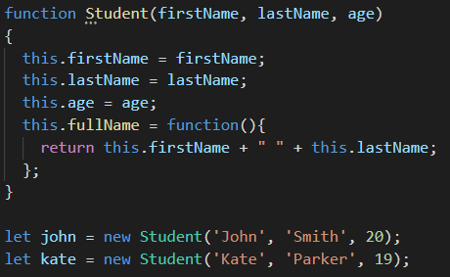
Prototype in JavaScript
john
’John’
’Smith’
20
fullName()
kate
two instances of function fullName that do the same thing
’Kate’
’Parker’
19
fullName()

Slide 4
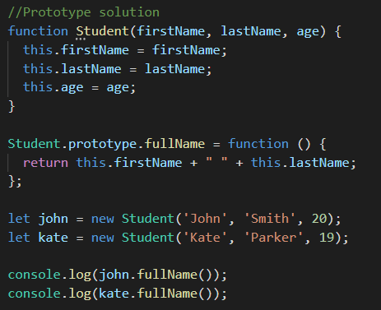
Prototype in JavaScript
Student
Prototype Object
Prototype property
constructor property
john
’John’
’Smith’
20
__proto__
kate
’Kate
’Parkr’
19
__proto__

